Slide 1


BUILD AGENTIC AI WORKFLOWS IN LANGGRAPH

Slide 2










Project Overview
In this project, we will build an advanced AI agent that can perform web searches, find popular attractions, check weather conditions, and search for flights and hotels using LangGraph.
Agent Outputs
Agent Input
Plan a trip to Paris
© All rights reserved for Dr. Ryan Ahmed @Stemplicity Inc.
Tools
tavily_search_tool,
search_hotels_tool,
closest_airport_tool,
flight_search_tool,
get_current_date_tool,

Slide 3

Key Learning Outcomes
Understand the basic concept of building Agentic AI workflows in LangGraph.
Configure API Keys for external tools to perform web search, finding flights, & weather conditions.
Understand the core components of LangGraph including states, edges, & conditional edges, & nodes.
Connecting our LangGraph agent to a user interface so users can interact with it using Gradio.
Define custom tools that AI Agents can leverage as part of their Workflows.
Define LangGraph workflows that include conditional edges & Multi-stage nodes.
© All rights reserved for Dr. Ryan Ahmed @Stemplicity Inc.

Slide 4
WHAT IS LANGGRAPH?

Slide 5


What is an AI Agent?
AI agents are autonomous systems that operate independently over extended periods, using various tools to accomplish complex tasks. The first basic block is an augmented LLM!
LLM
In
Out
© All rights reserved for Dr. Ryan Ahmed @Stemplicity Inc.
Retrieval
Memory
Tools

Slide 6
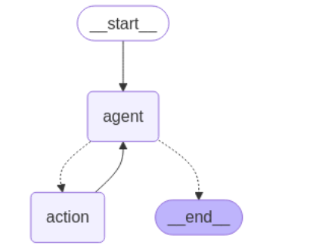
What is LangGraph?
LangGraph is a powerful framework that allows developers to build stateful, multi-agent applications with structured reasoning.
It is used to build autonomous AI agents and chatbots easily, and it’s open-source and is free to use.
LangGraph makes it easier to define workflows, manage state transitions, and add memory to AI-powered apps.
© All rights reserved for Dr. Ryan Ahmed @Stemplicity Inc.

Slide 7
LangGraph Key Components
Node
This includes the code (function) to execute
Node A
Edge
Node B
Edges determine which node to execute next
Node B
Conditional Edges determine which node to execute next based on a condition
© All rights reserved for Dr. Ryan Ahmed @Stemplicity Inc.
Node A
Conditional Edge
Node C
Graph State
Inputs
Variables
Graph state stores inputs and outputs and is accessible everywhere
Outputs

Slide 8
LangGraph Key Features
LangGraph’s low-level primitives provide the flexibility needed to create fully customizable agents with diverse control flows (single, multi-agent, hierarchical).
Prevent agents from veering off course with easy-to-add moderation and quality controls. Add human-in-the-loop checks to steer and approve agent actions.
LangGraph’s built-in memory stores conversation histories and maintains context over time, enabling rich, personalized interactions across sessions.
Bridge user expectations and agent capabilities with native token-by-token streaming, showing agent reasoning and actions in real time.
© All rights reserved for Dr. Ryan Ahmed @Stemplicity Inc.

Slide 9
LangChain Vs. LangGraph
Feature | LangChain | LangGraph
Architecture | Sequential / modular | Graph-based / stateful
Control Flow | Python logic (if/else, loops) | Explicit graph edges & conditions
Best For | Basic apps, linear chains | Multi-agent workflows, iterative systems
State Management | Stateless or basic memory | Built-in support for state between steps
Complexity | Easy to start | More complex but powerful
Example Use Case | Chatbot, QA system | Collaborative agents, research loops
© All rights reserved for Dr. Ryan Ahmed @Stemplicity Inc.

Slide 10

Summary
Learned how agents, nodes, edges, states, and conditions work together to form the foundation of a LangGraph workflow.
Designed intelligent workflows by incorporating branching logic, conditional edges, and multi-stage nodes.
Integrated external tools by configuring API keys and creating custom tools for tasks like search, weather, and flight lookup.
Enabled user interaction by connecting workflows to interfaces such as Gradio for real-time engagement.
Applied your knowledge to build smart, task-oriented AI systems that solve real-world problems.
© All rights reserved for Dr. Ryan Ahmed @Stemplicity Inc.

Slide 11
Thank you!

